Slide 1
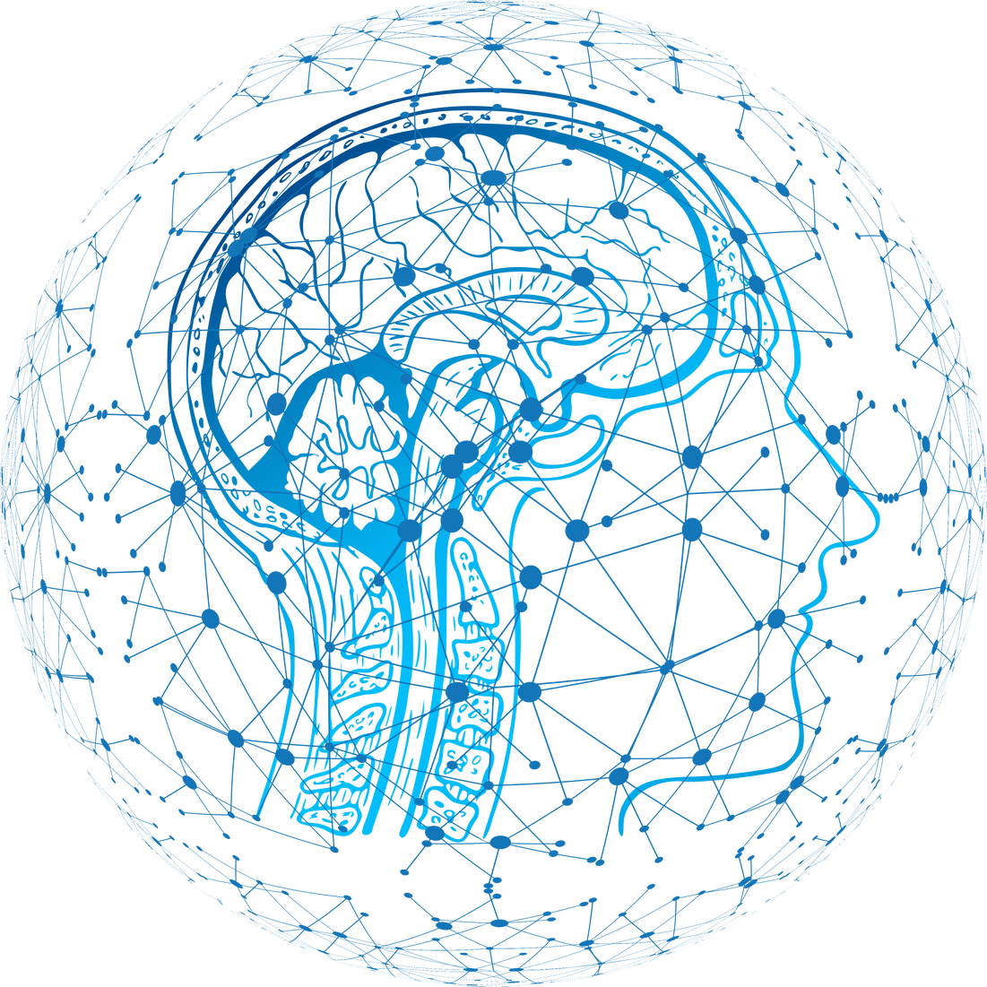
Biweekly
Presentation
- Syed Wamiq ul Islam
01

Slide 2
Topics covered so far
CNNs (Convolutional Neural Network)
01
Perceptrons / MLPs
04
Forward and Backward Propagation
Hands-on Implementations
02
05
Tuning Hyperparameters & Regularisation
03
06
02

Slide 3
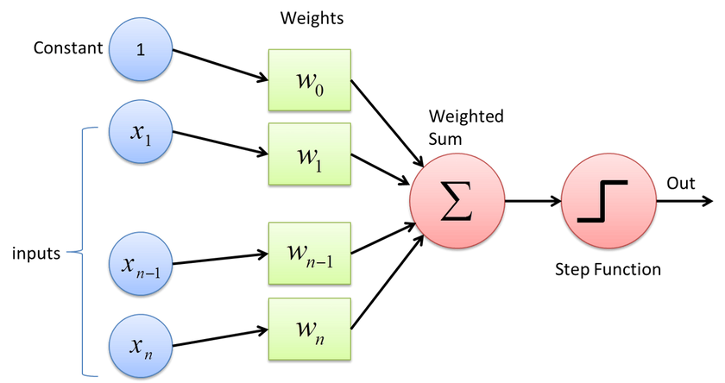
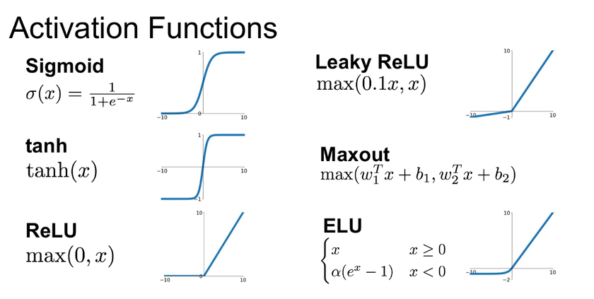
Perceptrons
Explored how perceptrons act as the basic computational units of neural networks, mimicking biological neurons by processing inputs into outputs.
Forward Propagation
Understood how input data flows through layers of a neural network to generate predictions using weighted sums and activations.
Activation Functions
Discovered how activation functions introduce non-linearity, enabling networks to learn complex patterns beyond linear relationships.
03

Slide 4
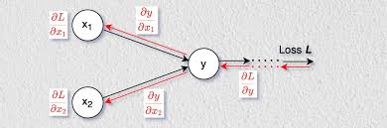
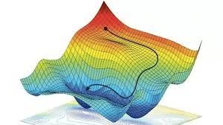
Backpropagation
Studied how backpropagation calculates gradients of the loss with respect to weights to guide learning via gradient descent.
Loss
Learned how loss functions quantify the error between predicted and actual outputs, serving as the objective for optimization.
Gradient Descent
Learned how gradient descent is used to optimize neural network weights by minimizing the loss through iterative updates.
04

Slide 5
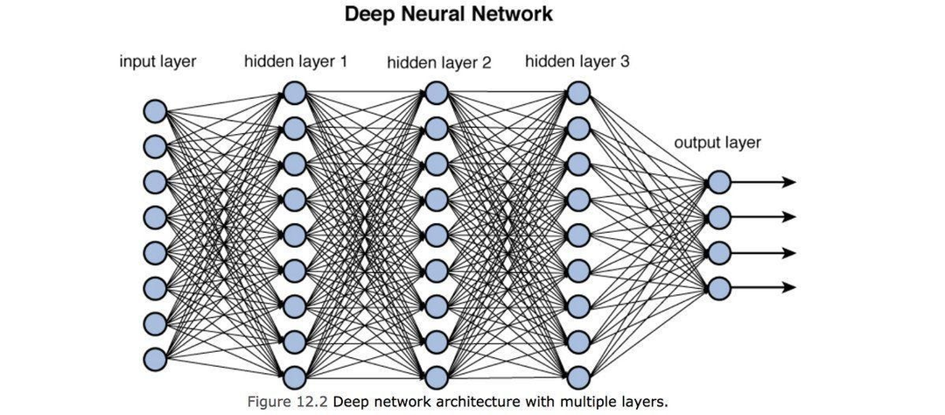
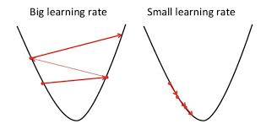
Multi-Layer Perceptrons
Explored how multi-layer perceptrons (MLPs) extend simple perceptrons by stacking multiple hidden layers, allowing the network to learn deeper, more abstract patterns. Learned how this depth enables the model to represent complex functions by progressively transforming inputs through each layer. Understood that MLPs form the basis of deep neural networks used in modern machine learning and studied the
Effects of Hyper parameters such as
Learning rate
Depth & Width
Batch Size
Activation Function
Optimizer
Loss Function
05

Slide 6
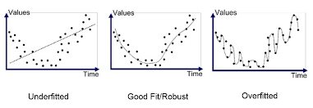
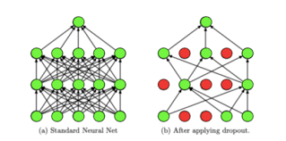
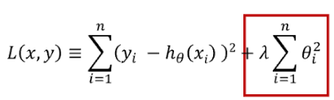
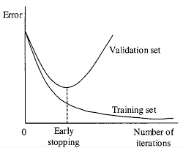
Regularisation
Techniques used to reduce overfitting by controlling model complexity and improving generalization to unseen data such as:
L2 Regularisation (Weight Decay)
Dropout
Randomly disables a fraction of neurons during training to prevent over-reliance on specific paths in the network.
Early Stoppage
Stops training when validation loss stops improving, preventing overfitting to the training data.
Batch Normalisation
Normalizes activations within a mini-batch to stabilize training and provide slight regularization.
06

Slide 7
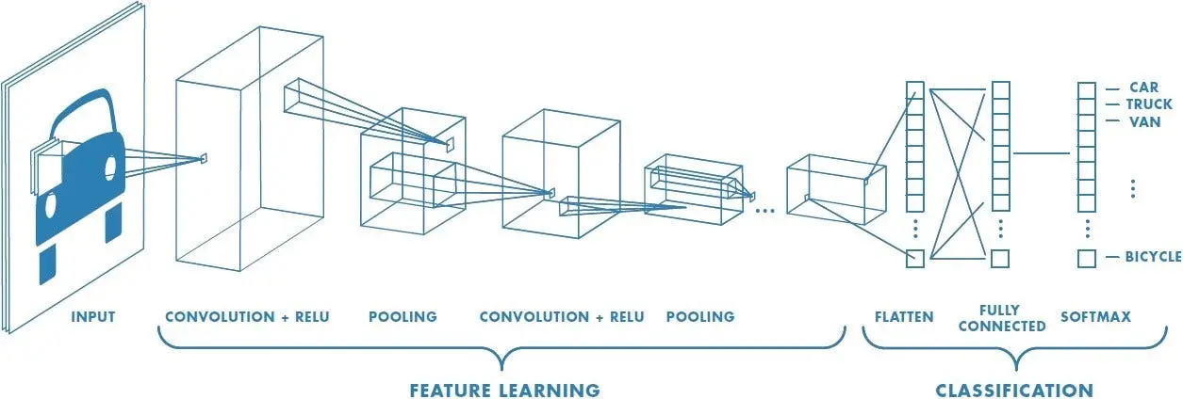
Convolutional Neural Networks (CNNs)
Convolutional Neural Networks (CNNs) use convolutional layers to scan input images with learnable filters that detect local patterns like edges and textures. These features are passed through multiple layers to capture increasingly abstract representations, while pooling layers reduce spatial size. This structure makes CNNs highly effective for visual tasks by preserving spatial relationships and reducing the number of parameters.
07

Slide 8
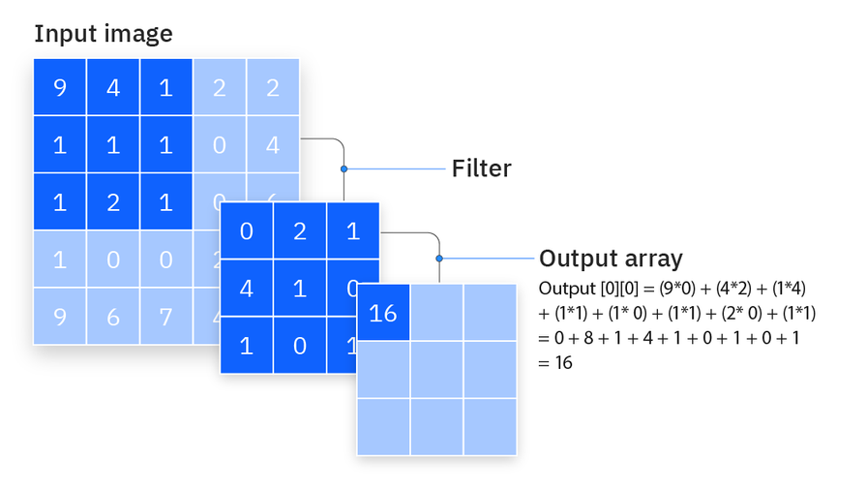
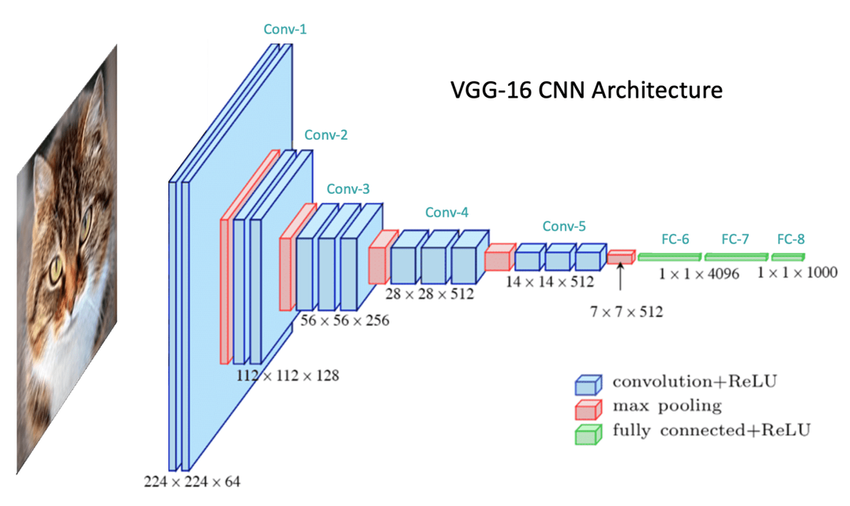
Convolution
Applies small filters across the input to extract local features like edges, textures, and shapes. Helps preserve spatial structure and reduces the number of parameters.
Pooling
Reduces the spatial size of feature maps by summarizing regions (e.g., max or average pooling). Improves efficiency and makes the model more robust to shifts and distortions.
08

Slide 9
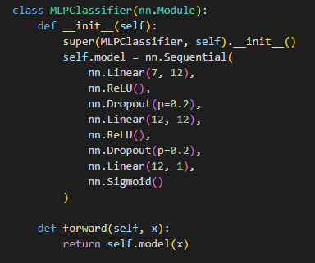
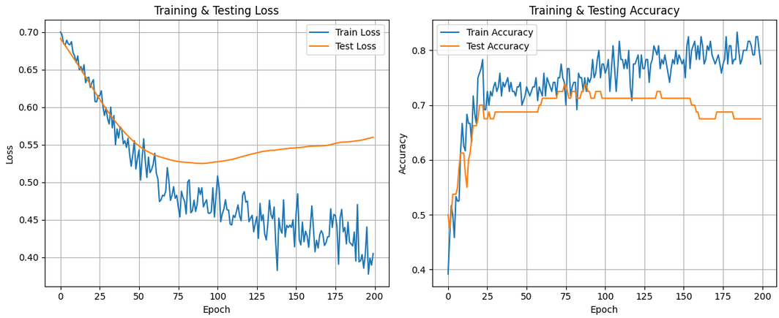
Hands-On Implementation
Multi-Layer Perceptrons
Implemented a binary classifier using MLPs to predict customer churn based on features like age, account length, and service usage. Trained the model on labeled data to learn patterns associated with customer retention and dropout.
09

Slide 10
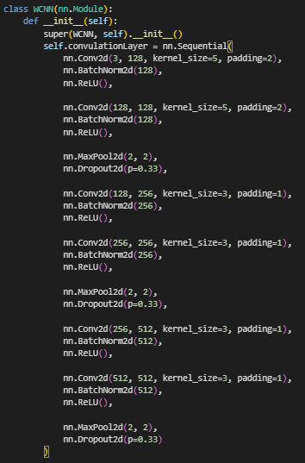
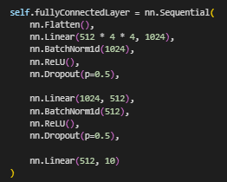
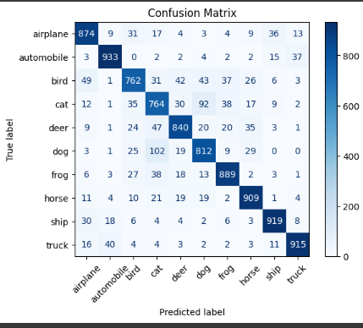
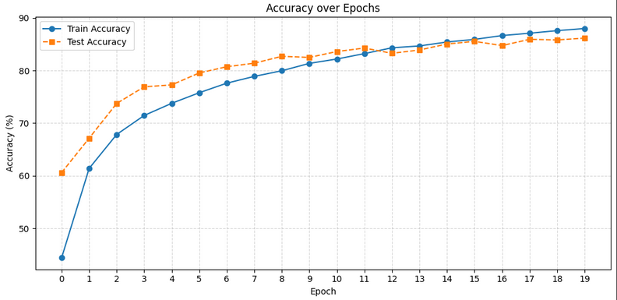
Convolutional Neural Networks (CNNs)
Implemented a CNN for the CIFAR-10 dataset to classify images into 10 categories, and trained it using labeled image data.
Also studied and implemented a prebuilt ResNet model to compare performance and understand how deep residual connections improve training in deeper networks.
10

Slide 11
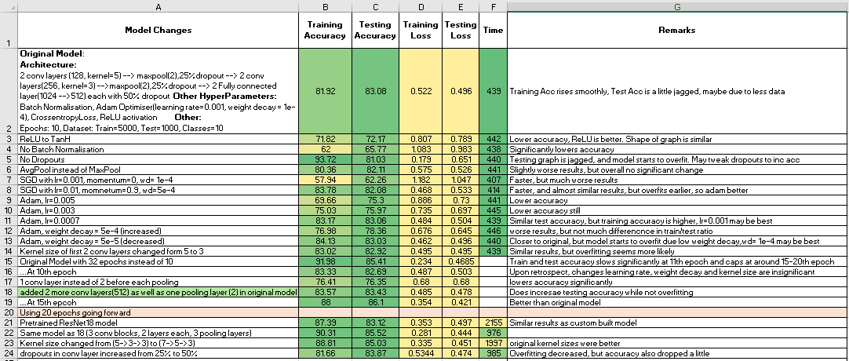
Convolutional Neural Networks (CNNs)
Studied the effects of changing hyperparameters such as learning rate, batch size, optimizer, and regularization techniques on the model’s accuracy. Observed how these choices influence training speed, overfitting, and overall performance on the test set.
11

Slide 12
Thank You
12

